Slide 1


Slide 2

HSE TALKING TOOLKIT
The law requires all employers to assess the risk of work-related stress and to put steps in place to tackle those risks.
Conversation 1 – Demands
Conversation 2 – Control
Conversation 3 – Support
Conversation 4 – Relationships
Conversation 5 – Role
Conversation 6 – Change
The Talking Toolkit can form part of an organisation’s response but should not be used in isolation as the employer’s only measure to prevent stress.

Slide 3
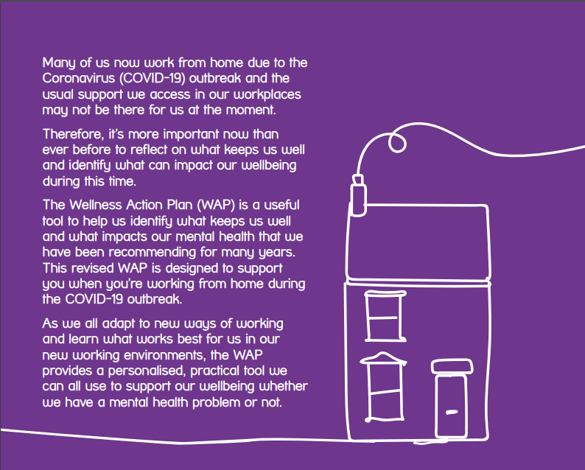

Working from home:
a Wellness Action Plan

Slide 4
Creating a mentally healthy workplace
Promote wellbeing at work
Equip managers and staff with the skills to support themselves and others
Provide information about - or access to - support
Training options for your workplace:
Become a Mental Health First Aider
Become a MH Champion
Become Mental Health Aware
Managers Training
Bespoke courses and workshops
Get in touch - training@westkentmind.org.uk

Slide 5
Wellbeing events
Mental Health First Aiders
Keynote speakers
Mentoring for MH First Aiders
Self care workshops
Bespoke training for client support teams
Staff feel supported…
…and feel more equipped to support their clients and each other
Mental Health for Managers training

Slide 6
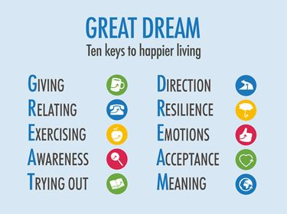
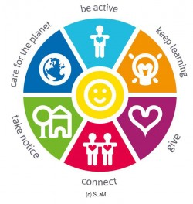
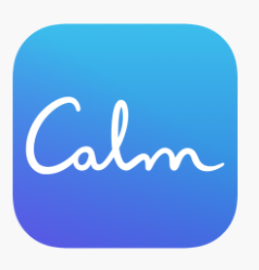
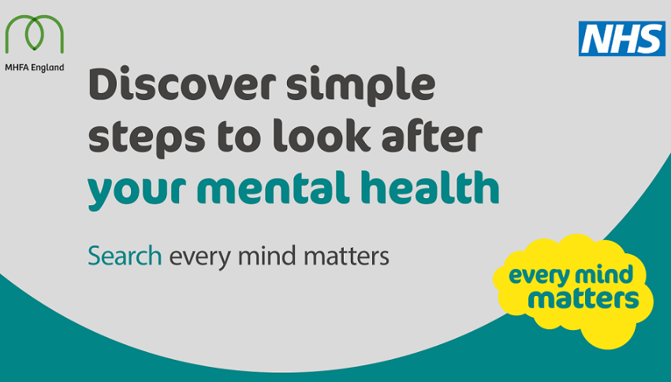

Self care

Slide 7

Contact Us
Visit: www.westkentmind.org.uk
Call: 01732 744950
Email: hello@westkentmind.org.uk
Follow: @westkentmind

Slide 8


You will receive an email in the next 24 hours with a link to the presentation slides and webinar recording.
We will also be following up with a written article covering the issues discussed today, as well as answers to the questions submitted on registration.
If you have any further questions for the speakers, please email: events@brachers.co.uk

Slide 9
Useful links and resources
West Kent Mind - https://westkentmind.org.uk/
Health & Safety Executive - find out how to manage work-related stress so you can protect your employees - https://www.hse.gov.uk/stress/
Including the Talking Toolkit - https://www.hse.gov.uk/stress/assets/docs/stress-talking-toolkit.pdf
Mind – Wellness Action Plans - https://www.mind.org.uk/workplace/mental-health-at-work/taking-care-of-your-staff/employer-resources/wellness-action-plan-download/
Mental Health at Work - your gateway to documents, guides, tips, videos, courses, podcasts, templates and information from organisations across the UK, all aimed at helping you get to grips with workplace mental health. - https://www.mentalhealthatwork.org.uk/

Slide 10
Useful links and resources
Wheel of Wellbeing - https://westkentmind.org.uk/six-ways-to-wellbeing
Action for Happiness - https://www.actionforhappiness.org/ and 10 keys to happier living - https://www.actionforhappiness.org/10-keys-to-happier-living
Calm - the #1 app for sleep and meditation - https://www.calm.com/
Headspace - Everyday Mindfulness and Meditation for Stress, Anxiety, Sleep, Focus, Fitness, and More - https://www.headspace.com/
NHS Every Mind Matters - Having good mental health helps us relax more, achieve more and enjoy our lives more. Find expert advice and practical tips to help you look after your mental health and wellbeing - https://www.nhs.uk/oneyou/every-mind-matters/

