Slide 1




In partnership with 7BR
Current Employment Tribunal trends:
The growth in whistleblowing claims
Thursday 10 December 2020
Webinar supporter:

Slide 2

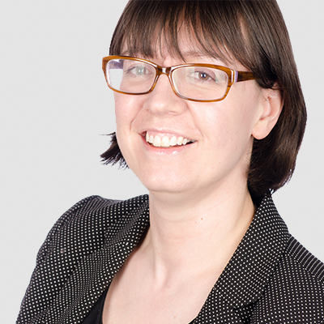
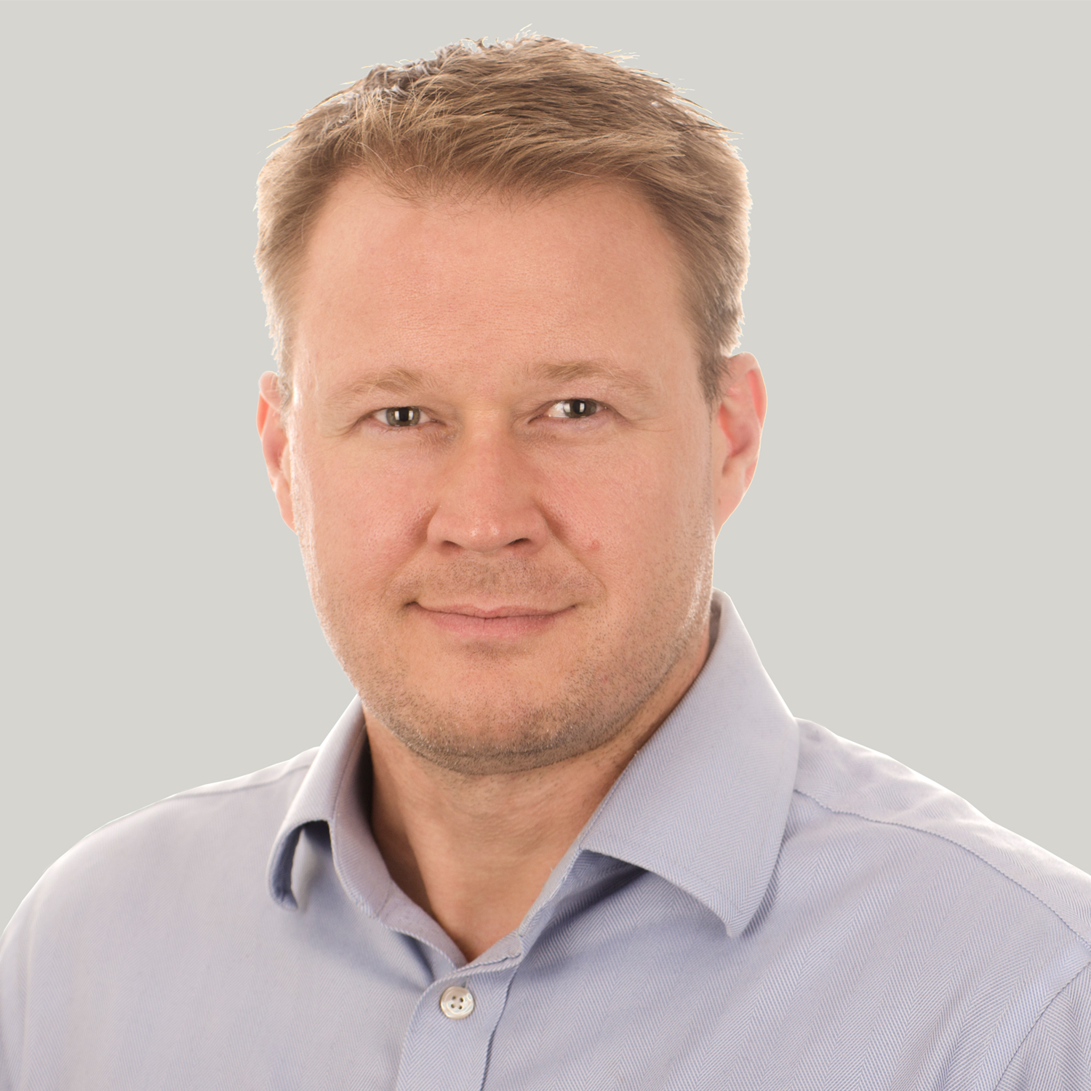
Webinar hosts
Catherine Daw | Partner and Head of Employment and HR, Brachers LLP
CatherineDaw@brachers.co.uk
Catherine joined Brachers on qualification in 1999 and became a Partner in 2003. She leads the Employment and HR Team and has a reputation for providing clear, practical and client-focussed advice. She is an experienced and pragmatic lawyer and has been representing employers on all aspects of employment law including restructures, TUPE transfers, employment tribunal claims and contracts of employment since 1999.
Catherine is noted in leading legal directory Chambers and Partners for her expertise advising clients in the healthcare sector on complex employment issues. A client interviewed by Chambers described Catherine as "an exceptional lawyer who is extremely responsive and always delivers the required outcome."
Colin Smith | Partner, Brachers LLP
ColinSmith@brachers.co.uk
Colin qualified in 2001 and has specialised in employment law for over 15 years, becoming Partner at Brachers in 2012.
Colin is committed to finding solutions for his clients - whether that may be a tricky workplace grievance or disciplinary, all the way through to large scale collective redundancies, TUPE transfer or tribunal claims.
Colin specialises in reorganisations, redundancy and restructuring, TUPE (transfer of undertakings), settlement and compromise agreements and Employment Tribunal claims.

Slide 3
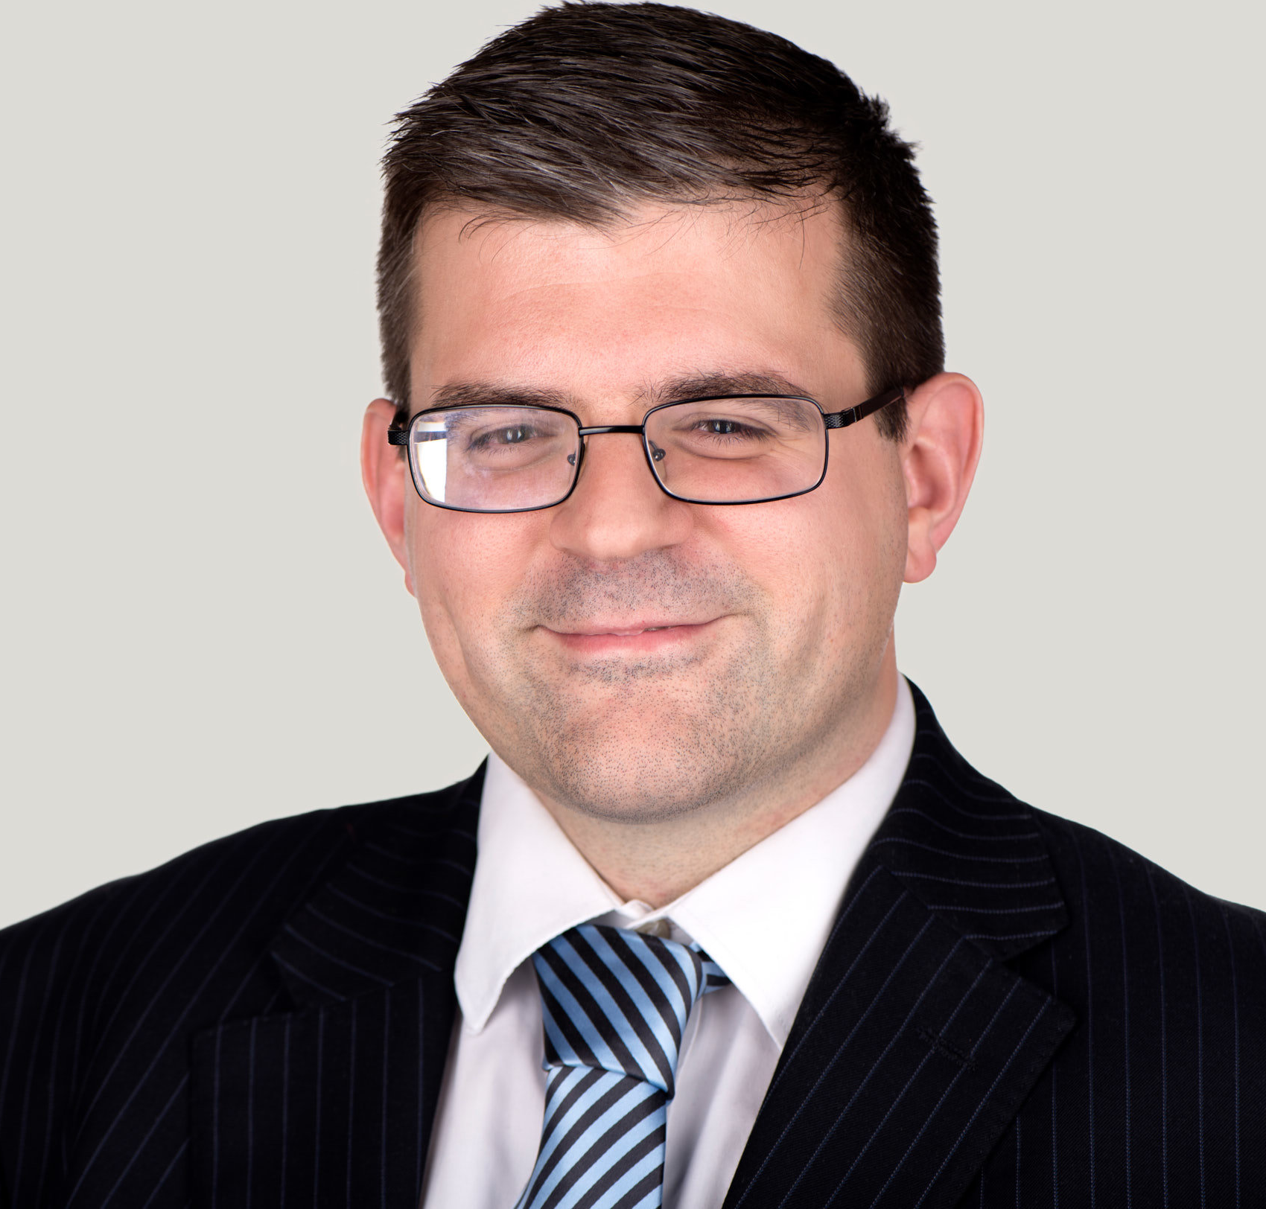
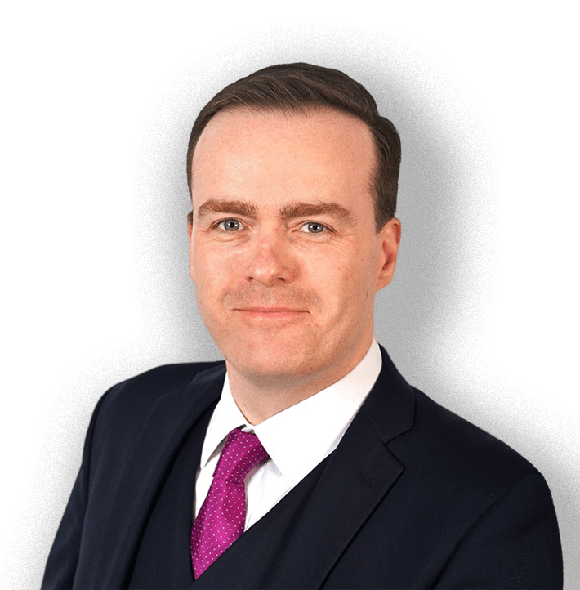
Webinar speakers
Antonio Fletcher| Partner, Brachers LLP
AntonioFletcher@brachers.co.uk
Antonio has significant experience advising on all aspects of employment law and also advised clients on data protection matters such as data subject access requests, breach reporting and requests for information under the Freedom of Information Act.
Antonio has acted on a broad range of contentious matters in both the Employment Tribunal and Employment Appeal Tribunal and has been representing employers in employment tribunal claims since 2007. These have included multi-party claims and claims linked to wider shareholder and board-level disputes and have covered a full range of employment-related claims including equal pay, victimisation, harassment and discrimination.
Dr Gregory Burke | Head of the Employment Law, 7BR
GBurke@7br.co.uk
Gregory is listed in Chambers & Partners as an “accomplished and robust advocate recognised for his expertise in discrimination claims [having] superb knowledge [and being] just outstanding”.
Gregory specialises in discrimination – in particular disability discrimination – and whistleblowing. He is regularly instructed on multi-week cases and has a growing reputation for forensic cross-examination which has been judicially praised.
Gregory was called to the Bar in 2012 following a successful business career; founding and growing a £2.5m turnover business accessable.co.uk; which supports organisations and employers to communicate their access to disabled people and develop inclusive policies and practices. He remains the owner and Chairman. Cranfield MBA magazine named Gregory one the UK’s “top social entrepreneurs”.

Slide 4


01
What is a Protected Disclosure?
02
When will an individual be protected?
Today’s session – Dr Gregory Burke
03
What to do if issues are raised with external parties
04
What to expect if the matter becomes contentious

Slide 5
01
How the employer can protect itself
02
Whistleblowing policies – what should they include?
Today’s session – Antonio Fletcher
03
Training managers to identify protected disclosures
04
Practical steps to manage protected disclosures

Slide 6


Test

Slide 7

“Could you please provide me with some advice on what my Territory Managers should do in terms of driving in the snow. Is there a company policy and has a risk assessment been done?”
Examples

Slide 8
“I was hoping for some formal guidance from the company. The team are under a lot of pressure to keep out on the roads at the moment and it is dangerous. Do I log this as the formal guidance?”
Examples

Slide 9
“I am only after a simply [sic] policy statement to increase transparency and help build morale and goodwill within the team. As their manager I also have a duty to care for their health and safety. Having spent most of Monday and Friday driving through snow I know how dangerous it can be. In addition the time spent battling through the snow is unproductive; they can gain more sales by phoning customers. If they are not going to be paid then I have to put in contingencies for diverting calls to those team members still on the road. In the absence of any formal guidance I take full responsibility for the directions given to my team.”
Examples

Slide 10
The Key topics from today:-
Know what a protected disclosure is and how to identify one
Train your managers
Have a clear policy in place
Make sure your staff know about it
Manage external disclosures appropriately
Employer Protection

Slide 11

Consider the background:-
Employees with short service
Employees looking for larger awards
COVID-19
Home workers
Health and safety
Your organisation’s greatest risk areas
Employer Protection

Slide 12
Keep an open mind as to what could amount to be whistleblowing
Do not dismiss concerns out of hand if they seem trivial to you
Investigate concerns promptly
Confidential whistleblowing hotline?
Employer Protection

Slide 13
Be mindful of additional rules and considerations
Financial Conduct Authority
Prudential Regulation Authority
Listed companies
Public sector
Employer Protection

Slide 14
No positive obligation on employers to have a policy or to encourage whistleblowing in law
The aim of whistleblowing legislation is to promote “a climate of openness and transparency in which individuals in the workplace do not feel that they will be victimized if they draw attention to wrongdoing”
Whistleblowing Policies

Slide 15
Why have one?
Compliance and control
Avoiding external disclosures
Reduce litigation risk
Reporting bribery
Slavery and human trafficking statements
Avoiding criminal liabilities for tax evasion
Whistleblowing Policies

Slide 16
Convey the seriousness and importance the employer attaches to identifying and remedying wrongdoing
Encourage concerns to be raised internally
Remind workers of standards expected of them
Make it clear who to approach with a concern
Whistleblowing Policies

Slide 17
Enable workers to by-pass individuals or layers of management if needed
Detail the investigation process and consequences of wrongdoing
Consequences of victimising whistleblowers and of malicious disclosure
Provide access to further sources of advice
Whistleblowing Policies

Slide 18
Allow employee to be accompanied
Keep a record of meetings
Allow flexibility as to the extent and nature of investigation
Give feedback on corrective action
Allow escalation if unsatisfied with outcome
Whistleblowing Policies

Slide 19
Ensure the policy fits alongside your other policies and contracts
Clearly endorse the policy with visible engagement from senior stakeholders
Be mindful of data protection issues
Consider how you can measure success
Whistleblowing Policies

Slide 20
Make sure your managers know:
What could amount to a protected disclosure?
What protection does this afford the individual?
Where your policy can be found and what it says
What actions they should take
Management Training

Slide 21
Also ensure that managers are aware that:
They should not do anything that may victimise a whistleblower
And ensure that others do not
The consequences for victimisation of a whistleblower or obstructing an investigation are serious
Management Training

Slide 22
When faced with a protected disclosure makes sure that the whistleblower:
is aware of your policy and the process that will be followed;
is reassured (by actions and words) that their complaint is being dealt with seriously;
is promptly given the opportunity to express their concerns
Practical Steps

Slide 23
Reassure the whistleblower that confidentiality will be respected where relevant
Consider whether there is any risk that they will suffer detrimental risk from others and take steps to eliminate that risk
Ensure that the concerns are considered objectively – are you (or others) too “close” to the concern?
Practical Steps

Slide 24
Try to understand what outcome the whistleblower is seeking
Ensure a thorough investigation to the issue is undertaken and that appropriate outcomes are given
Keep the whistleblower updated and maintain contact throughout the process
Practical Steps

Slide 25
When a satisfactory resolution cannot be reached for the individual:
Seek to maintain dialogue – can a positive way forward be found?
Be wary of the risk of allegations of detrimental treatment
Take a step back – what other viable solutions are there?
Learn from the experience
Practical Steps

Slide 26


Any Questions?

Slide 27
About Brachers
Brachers is an award winning law firm, providing valuable legal support to individuals and companies. Our client base includes private individuals and their families, SMEs, owner managed businesses, publicly funded organisations, healthcare organisations, schools, colleges, further education providers, charities, family businesses and multi-national corporations.
www.brachers.co.uk
About 7BR
7BR is a leading set of Barristers’ Chambers, based in Central London, with a countrywide and international reach and which prides itself on upholding certain core values and characteristics with the aim of achieving:
Excellence in legal advice
Excellence in advocacy before Courts and Tribunals
Excellence in service to clients, lay and professional.
With over 80 barristers, including 12 Queen’s Counsel, 7BR is well equipped to achieve these aims. We have recently completed the largest refurbishment in our history, enabling us to offer our lay clients, solicitors and colleagues across the Bar state of the art facilities to host conferences, seminars and training events on a frequent basis. This refurbishment is a measure of Chambers’ confidence in the continued existence of an independent Bar.
www.7br.co.uk
About webinar supporter: Diversity HR
Diversity HR is an established independent recruitment agency covering Sussex, Surrey, London and Kent. They have an outstanding reputation for HR recruitment, placing high calibre candidates within human resources jobs. Diversity HR offer a comprehensive, non-sales led, discreet and cost-effective recruitment service. They are essentially in-house recruiters with the ability to find candidates who match clients’ requirements.
www.diversityhr.co.uk

