Slide 1
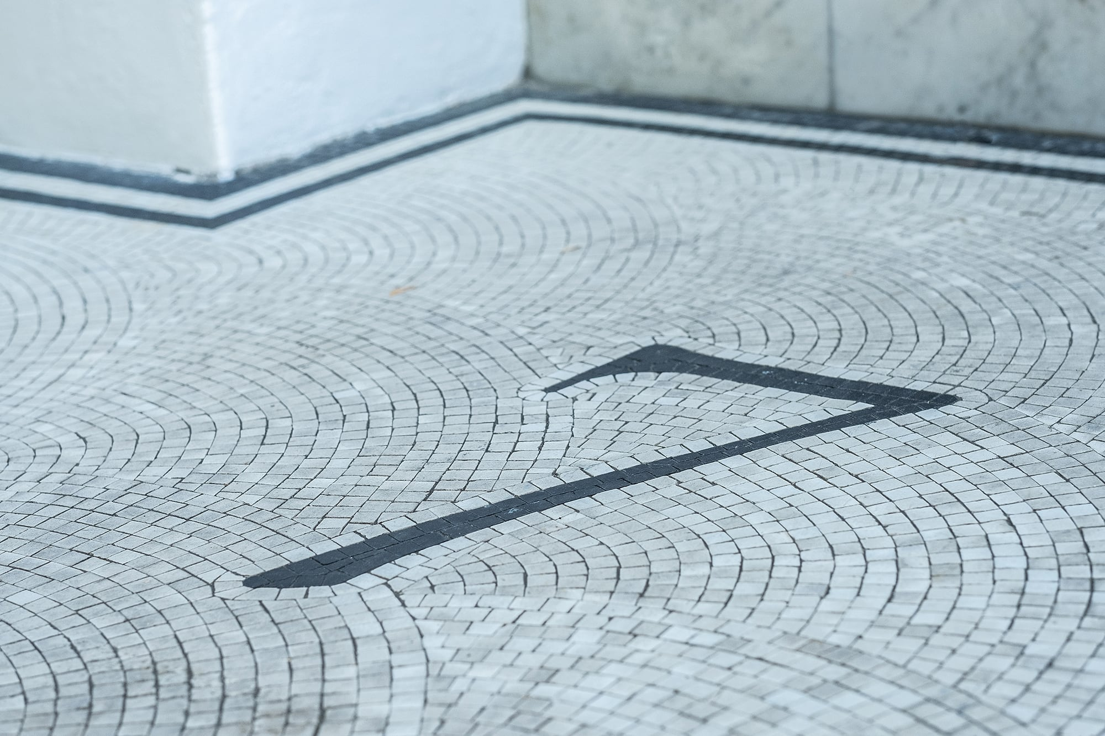
Whistleblowing Claims
Dr Gregory Burke

Slide 2
Why should you bother?
Financial risk
No requirement for minimum service
Attractive claim to pursue
Reputational issues

Slide 3
Overview
Who can make a protected disclosure?
What is a protected disclosure?
What is the protection?
When will an individual be protected?
Disclosures and external parties
What to expect at a hearing.

Slide 4
Who can make a protected disclosure?
Workers as well as employees
Wide definition of worker
Volunteers?

Slide 5
The heart of it
“…any disclosure of information which, in the reasonable belief of the person making the disclosure, is made in the public interest and tends to show one or more of the following – [six relevant failures]:
  …Criminal offence..
  …Legal obligation…
  …Miscarriage of justice…
  …Health and Safety….
  …Environment….
  …cover-up…

Slide 6
What does disclosure mean?
Not defined
Writing or verbal
Recording
May be new information but it does not have to be
Must convey facts
Information and allegation not mutually exclusive
Substance not form
Context is important

Slide 7
Six relevant failures
(a) that a criminal offence has been committed, is being committed or is likely to be committed;
(b) that a person has failed, is failing or is likely to fail to comply with any legal obligation to which he is subject;
(c) that a miscarriage of justice has occurred, is occurring or is likely to occur;
(d) that the health and safety of any individual has been, is being or is likely to be endangered,
(e) that the environment has been, is being or is likely to be damaged, or
(f) that information tending to show any matter falling within any one of the preceding paragraphs has been, or is likely to be deliberately concealed.

Slide 8
Reasonable belief
The worker can be wrong
But has to be reasonable
The information must tend to show
‘Reasonable belief’ not ‘belief’

Slide 9
In the public interest
No public interest, no protected disclosure.
1) did the worker subjectively believe at the time that disclosure was in the public interest;
2) if so, was that belief objectively reasonable.
‘In the public interest’, not ‘motivated by the belief in the public interest’.

Slide 10
When will the individual be protected?
Ticked all the previous boxes
Recipient must be one of the following categories:
  The worker’s employer
  The person responsible for the relevant failure;
  Legal advisers
  Government ministers
  A person prescribed by an order made by the Secretary of State
Only then will the worker be protected from detriments from his employer caused by the disclosure.

Slide 11
External disclosure
Not the same as appeals in a disciplinary procedure
More onerous conditions for the worker
  Reasonable belief it is substantially true
Must satisfy further conditions.
Overall effect is to discourage workers to disclose to external parties such as the press and police.

Slide 12
Protection from detriments
Disadvantage in circumstances in which they had to work
Worker has to show the necessary element of claim have been proved
Burden shifts to the employer to prove the worker was not subjected to detriment on the grounds of the making of a protected disclosure.

Slide 13
Contentious
Preliminary Hearing
Very low chance of strike out
Final Hearing
Where witnesses will be tested
Disputing causation
  Separable;
  Related

