Slide 1




Kent Good Governance Charity Forum Webinar
Tuesday 17 November 2020
In partnership with

Slide 2

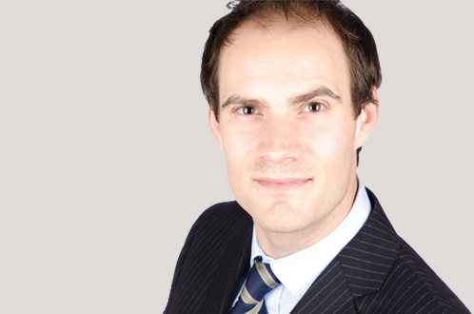
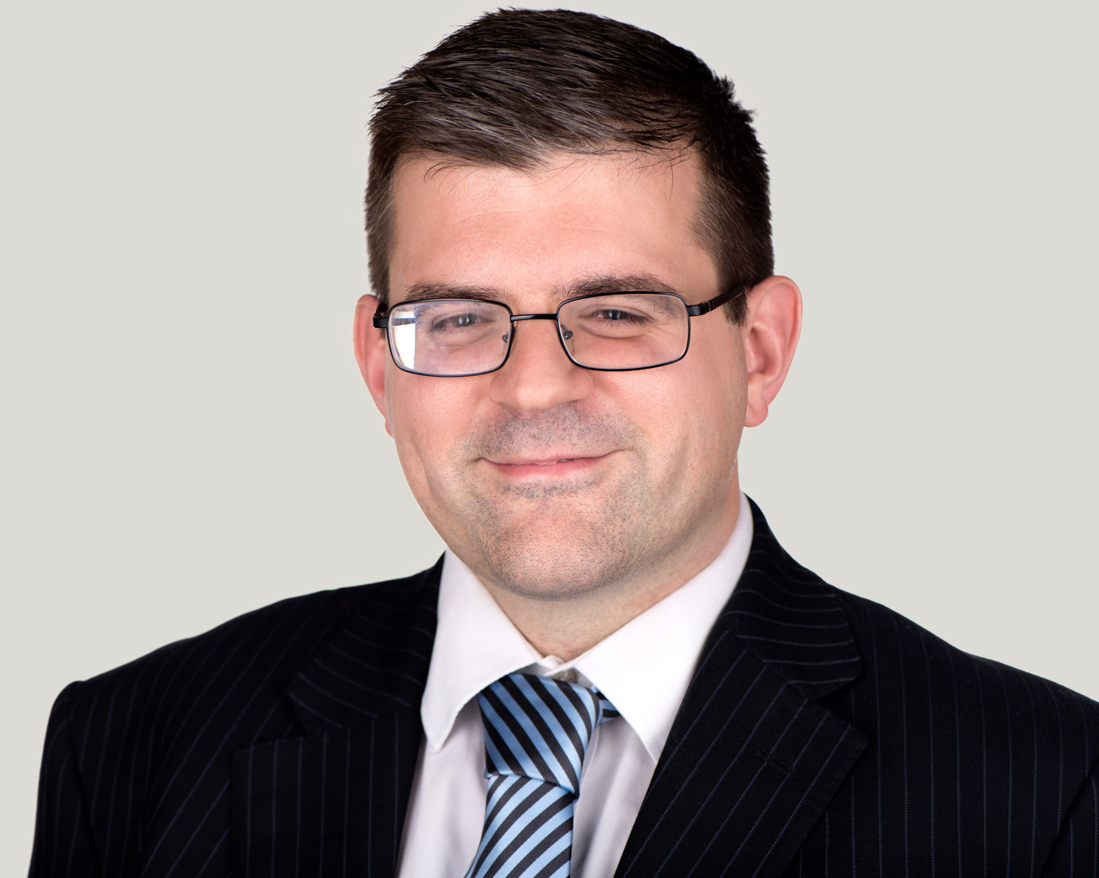
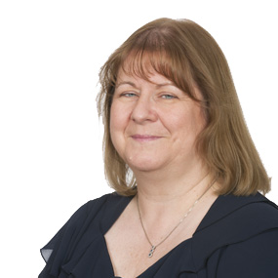
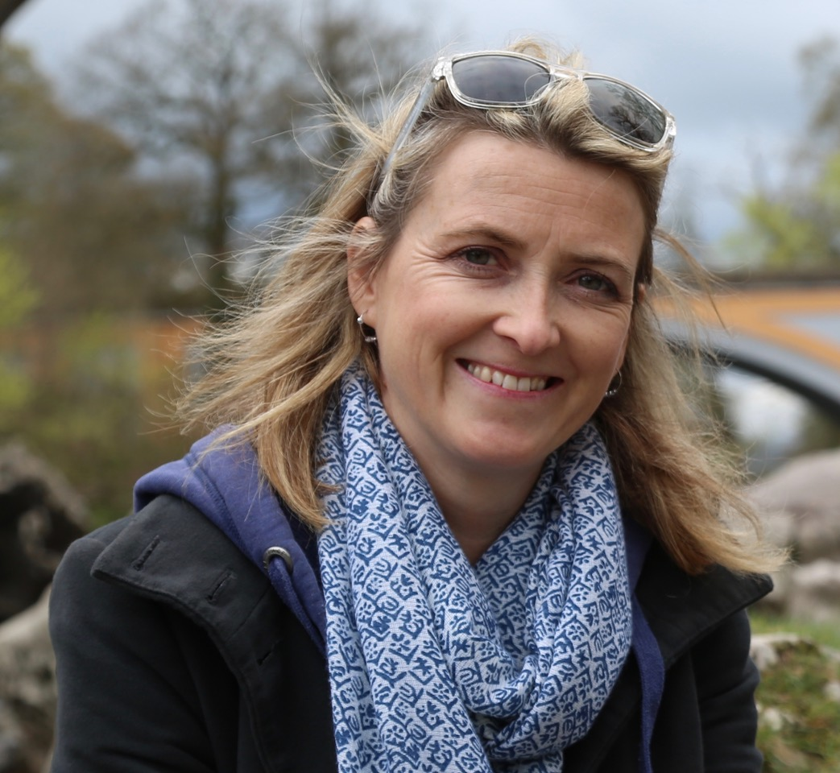
Webinar speakers
Christopher Eriksson-Lee, Partner and Head of Private Client, Brachers LLP | ChristopherEriksson-Lee@brachers.co.uk
Christopher is a Partner and head of the firm’s Private Client team. He advises a diverse range of clients including business owners and those with landed estates on succession planning, the preparation of wills, estate and tax planning, trust creation, powers of attorney and the administration of trusts and estates. Christopher is a trustee of West Kent Mind and is also a director of Brachers Trust Corporation Ltd, which provides the firm’s professional executor/trustee/attorney and deputy service.
Antonio Fletcher, Partner, Brachers LLP | AntonioFletcher@brachers.co.uk
Antonio is part of the charity sector team at Brachers and acts for a number of charities. He has significant experience in advising on all aspects of employment law including on employee transfers, restructures and redundancy exercises. Antonio is also a trustee of ACE Learning.
Susan Robinson BA FCA MCMI FCIE DChA, Accounts and Audit Partner, and Head of Charities and Not for Profit, Kreston Reeves | Susan.Robinson@krestonreeves.com
Susan is an expert on charities and their finances and regularly presents seminars to local charity managers and trustees on many different aspects of charities and their management. She is a registered individual for audit purposes, Chair and Fellow of the Association of Independent Charity Examiners (ACIE), a past Chairman of the Kent Executive Club and a member of the Chartered Management Institute. Susan is a current trustee of Age UK.
Stevie Rice, CEO, West Kent Mind | stevie.rice@westkentmind.org.uk
Stevie has 20 years’ experience working at senior management, director and board level with charities. She is currently the CEO of West Kent Mind, having joined in March 2019. She is a member of Mind’s Network Engagement Group and is proud to be a member of the national Network Committee for Mind. Previously she worked at Kent Wildlife Trust as the Director of Engagement and for nine years she led a disability arts charity as the CEO from inception which grew fast to impact positively on the national disability and deaf arts scene.

Slide 3


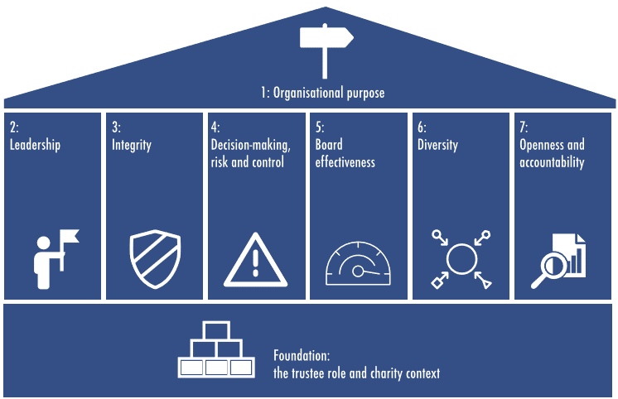
Charity Governance Code

Slide 4
What to do if there is a problem
Legal Duties
Promote charitable purposes and operate for benefit of public
Duty of prudence – prudent business person
Duty to act collectively - Charity trustees can usually act by majority
Undivided loyalty – ‘no profit ‘no conflict’
Act in good faith
Act in best interests of charity
Act within powers
Notes:
Charity trustees need to be wary of their legal duties to ensure that they don’t expose themselves to personal liability or the charity to undue risk
Fiduciary relationship – high standard of trust and confidence
Promote charitable purposes – if breached could be personally liable
Operate charity for benefit of the public
To act in best interests of charity and its beneficiaries
To act within powers – reviewing governing document
Duty of prudence – prudent business person
Duty to act collectively - Charity trustees can usually act by majority

Slide 5
Paper trail
Fundamental to ensure compliance with the Code
Board Meetings – agendas and minutes
Written record of key policies and procedures
Notes:
Agenda should record include – declarations of interests (conflicts of interest), review of charity finances, review of risk aspects, report on operational activity
Board meeting minutes record – evidence the regularity of meetings and acting collectively, key decisions taken, key operational aspects delegated and consideration of risks – record of things that go wrong
The board regularly reviews the charity’s key policies and procedures to ensure that they continue to support, and are adequate for, the delivery of the charity’s aims. This includes policies and procedures dealing with board strategies, functions and responsibilities, finances (including reserves), service or quality standards, good employment practices, and encouraging and using volunteers, as well as key areas of activity such as fundraising and data protection.
Board regularly reviews which matters are reserved to the board and which can be delegated (4.5.1)
Regular reviews of key policies and procedures to ensure aims are met (4.5.5)
Trustees keep their independence and tell the board if they are being influenced/conflict (3.5.4)

Slide 6
Decision making
Consideration of governing document
Act within powers
Act in good faith, and only in the best interests of charity and beneficiaries
Sufficiently informed
Take account of all relevant factors you are aware of and Ignore any irrelevant factors
Notes:
Governing Doc
The governing document does depend on the type of legal form or structure…Trust corporation (Trust document); Company (Articles and Company Act); CIO (Charities Act and CIO regulations)
What the charity exists to do (its purposes, as explained in its objects clause)
What powers it has to further its objects
Who the trustees are, how many trustees there should be and how they are appointed and removed
Whether the charity has members and, if so, who can be a member
Rules about trustees’ (and members’) meetings; how they are arranged and conducted; how decisions must be made and recorded, and so on
How to change the governing document
How to close the charity down
Consider the following:
Act within your powers
Act in good faith, and only in the interests of your charity
Make sure you are sufficiently informed, taking any advice you need
Take account of all relevant factors you are aware of and Ignore any irrelevant factors
Deal with conflicts of interest and loyalty
Make decisions that are within the range of decisions that a reasonable trustee body could make in the circumstances

Slide 7
Delegation
Can delegate day-to-day activities but set out limits
  Check governing document
  Prepare delegation policy/ framework
Sub-committees or senior staff
  Suitable membership
  Suitable terms of reference
High risk and unusual decisions should not be delegated – regular review of matters reserved to the board
Regular review of third-party agreements
Notes:
All trustees have appropriate skills and knowledge of the charity and have enough time to fulfil their role
Can delegate day-to-day activities but set out limits
The board describes its ‘delegations’ framework in a document which provides sufficient detail and clear boundaries so that the delegations can be clearly understood and carried out. Systems are in place to monitor and oversee how delegations are exercised.
Many charities have power to delegate decision making to sub-committees or senior staff
The board makes sure that its committees have suitable terms of reference and membership and that:
the terms of reference are reviewed regularly
the committee membership is refreshed regularly and does not rely too much on particular people.
High risk and unusual decisions should not be delegated
Trustees cannot delegate overall responsibility
Where a charity uses third party suppliers or services – for example for fundraising, data management or other purposes – the board assures itself that this work is carried out in the interests of the charity and in line with its values and the agreement between the charity and supplier. The board makes sure that such agreements are regularly reviewed so that they remain appropriate.

Slide 8
Managing risk
Board retains responsibility for risk management
Regular review of specific risks, cumulative effect and plans to mitigate and manage risks
Regular review of process for identifying, prioritising, escalating and managing risks and internal controls
Board describes the charity’s approach to risk in its annual report
Notes:
The board retains overall responsibility for risk management and discusses and decides the level of risk it is prepared to accept for specific and combined risks.
The board regularly reviews the charity’s specific significant risks and the cumulative effect of these risks. It makes plans to mitigate and manage these risks appropriately.
The board puts in place and regularly reviews the charity’s process for identifying, prioritising, escalating and managing risks and, where applicable, the charity’s system of internal controls to manage these risks. The board reviews the effectiveness of the charity’s approach to risk at least every year.
The board describes the charity’s approach to risk in its annual report and in line with regulatory requirements.

Slide 9
What to do if there is a problem
Serious incidents – record and report
Less serious:
  Record and consider action
  Minimise any further loss or damage
  Plan what to say to employees/ members
  Take steps to prevent reoccurrence
Notes:
Serious incidents record
Report serious incidents to commission/other regulators and police
If not serious then take prompt and appropriate action to:
prevent or minimise any further loss or damage
plan what you will say to your staff, volunteers, members, the public or the media
take reasonable steps to prevent it from happening again - review controls and procedures, take appropriate advice

Slide 10

Who can act as a trustee? (Disqualification)
Capacity
Must have capacity to manage their own affairs
Age restrictions
No upper age limit
Charitable trusts: minimum age 18
Charitable companies: minimum age 16
Disqualification
Must not:
Be disqualified as a company director
Have unspent conviction for a dishonest offence
Be undischarged bankrupt
Have been removed as trustee of a charity previously
Be on sex offenders’ register
Other
Charity governing document can impose other restrictions such as certain religious denomination
Charities involving safeguarding may require DBS check

Slide 11
Remuneration
Charities can not pay their trustees
Trustees are volunteering their services
You can pay reasonable expenses
Trustees (or someone with a financial connection to them) can not benefit from the charity, such as:
  Being employed by the charity
  Receiving material benefits as beneficiary of the charity
  Being paid to act as trustee
  Entering into property transactions with the charity
  Entering into financial transactions with the charity

Slide 12
Diversity in leadership and board positions
Diversity supports effective leadership, board effectiveness and decision making
Diversity in a broad sense:
  Nine protected characteristics
  Diversity of thought
  Representation
Diversity in a narrower sense:
  Career paths
  Life experiences
  Knowledge and professional skills
A charity is dependent on its trustees, an effective board means a thriving and successful charity

Slide 13
Recruitment
Think about diversity when recruiting trustees
Recommended practice:
Monitoring and reporting on diversity to identify gaps and imbalance
Removing obstacles to diversity:
  paying reasonable expenses
  time, location, frequency of meetings
  varied communication formats
Setting diversity objectives
Diversity present in trustee appointment panels

Slide 14
Recruitment
Think how to incentivise and attract the correct candidate
Tips:
Promote the role outside the boundaries of the charity’s network
Consider what the candidate wants from the role and how your charity can offer it:
  candidates often want to ‘give something back’
  gain skills for professional development; or
  are committed to the charity’s cause

Slide 15
Retention
Keeping the board feeling fulfilled is important in order to retain trustees
Recommended practice:
Provide a solid induction
Provide training and reflection
Understanding the board’s responsibilities
Asking for feedback on how meetings can be made more accessible
Ask for feedback on creating environment all trustees can be heard and participate in
Give opportunities to build relationships and form ideas to develop the charity

Slide 16
Sector change
Charity governance code
- principle 4 decision making
Cash has become king
- Cashflow
- Budgets
- Information

